Slide 1

The study of the gender in the tweeter
Lama AlKhateeb

Slide 2


Abstract:
The goal of this project was to use classification models to predict With the credibility of the tweeter's gender, whether that is true or not most popular words.

Slide 3
Data
The dataset contains 20050 datapoint with 26 features for each, The features I am using, such as gender ,gender confidence , profile , profile confidence , fav number , text , tweet count , The features are integer , float , string and bool.
(12 columns>>>>>14columns)
The goal is a gender

Slide 4
Geneder(object)
Male
Female
Brand
Unknouwn
Nan

Slide 5
Feature Engineering
Converting categorical features into numerical features

Slide 6
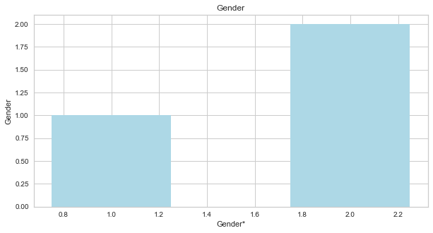
COMMUNICATION

Slide 7
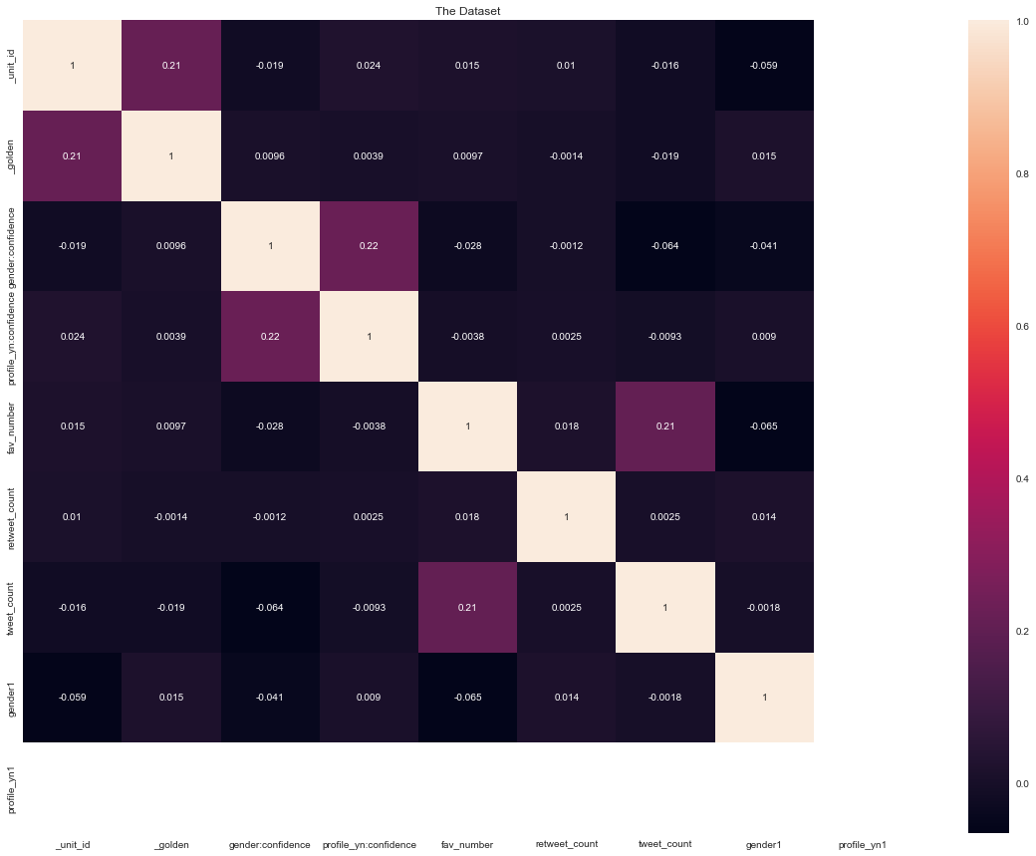
Heatmap

Slide 8
TOOLS
Numpy and Pandas for data processing
Scikit-learn for modeling
Matplotlib and Seaborn for visualization
Nltk and string for txet

Slide 9
ALGORITHMS
Models
Logistic Regression (The best model)
Decision Tree Classifier
Gaussian Naive-Bayes
Random Forest Classifier
K-Nearest Neighbours

Slide 10
Model Evaluation and Selection
The entire dataset of records was split into 80/20 train vs. test.

Slide 11
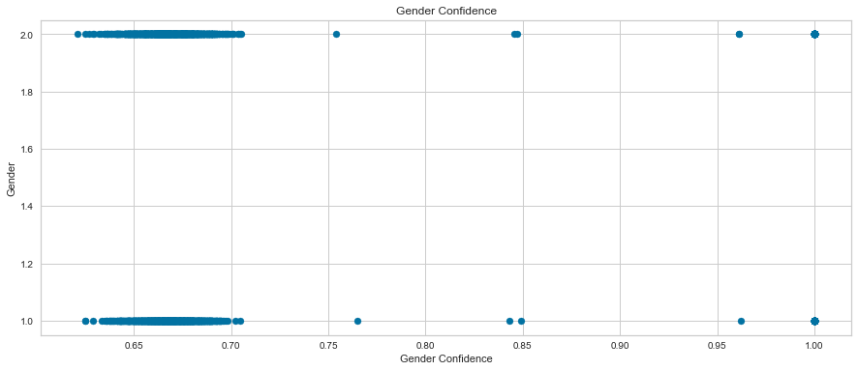
Geneder&Geneder conifidence

Slide 12
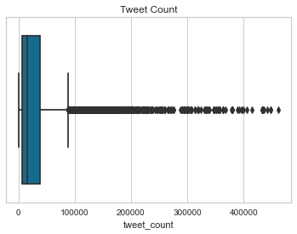

Slide 13
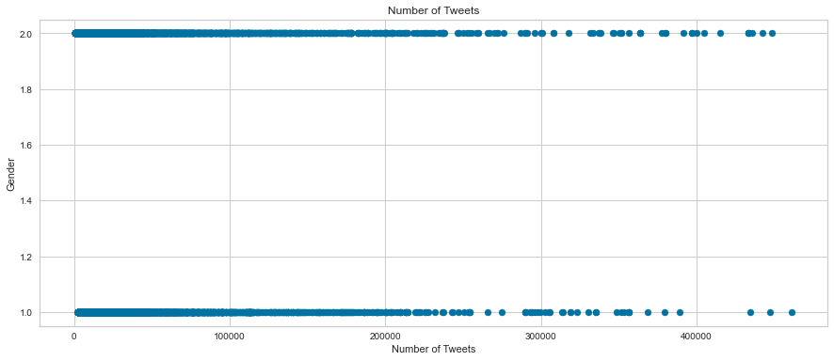
Number of Tweets

Slide 14
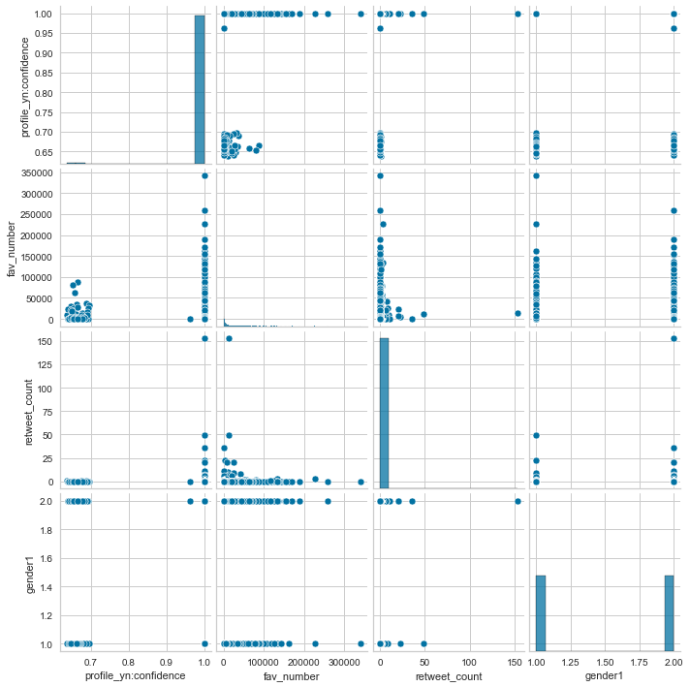

Slide 15
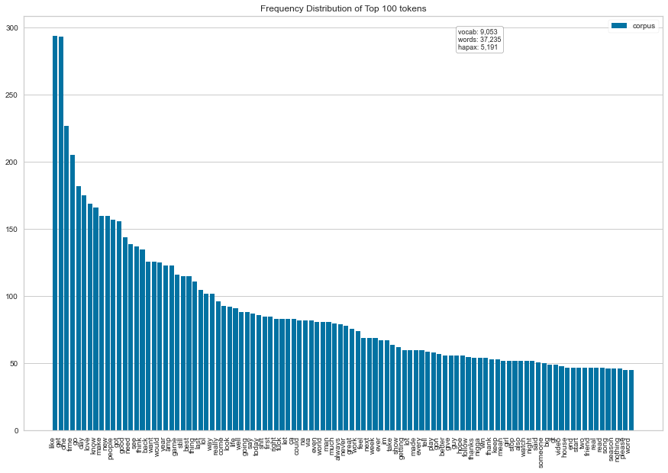
Male

Slide 16
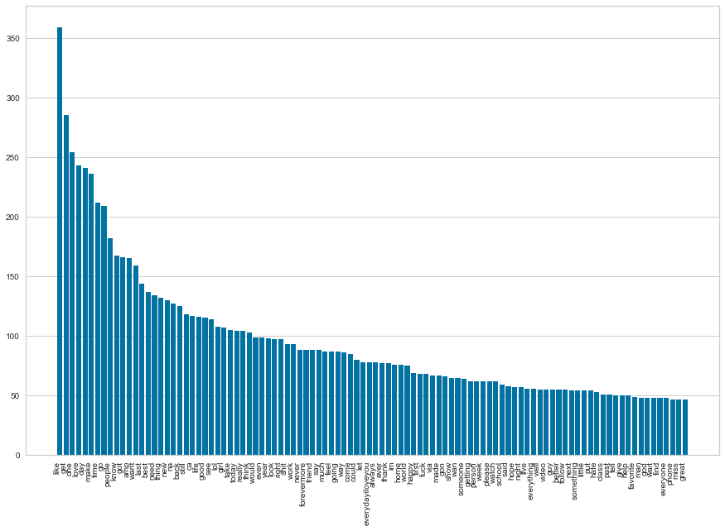
Female

Slide 17
conclusion
The 5 most common words used by females are 'like', 'get', 'one', 'love', 'day'.
The 5 most common words used by males are 'like', 'get', 'one', 'time', 'go'.

